Slide 1

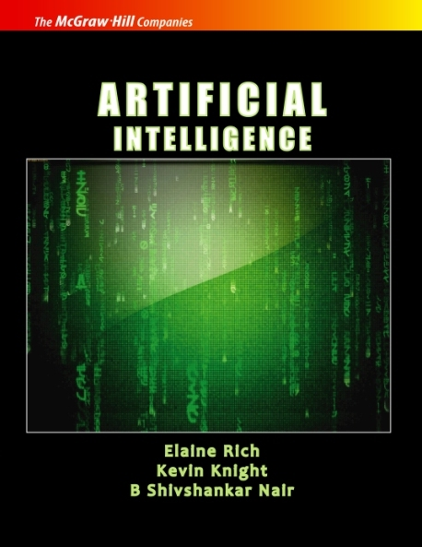
ARTIFICIAL INTELLIGENCE
Third Edition
Transparencies/Handouts
PROPRIETARY MATERIAL. © 2009 The McGraw-Hill Companies, Inc. All rights reserved. No part of this PowerPoint slide may be displayed, reproduced or distributed in any form or by any means, without the prior written permission of the publisher, or used beyond the limited distribution to teachers and educators permitted by McGraw-Hill for their individual course preparation. If you are a student using this PowerPoint slide, you are using it without permission.
13

Slide 2
 Table of Contents
1. What is Artificial Intelligence? 1
2. Problems, Problem Spaces, and Search 23
3. Heuristic Search Techniques 48
4. Knowledge Representation Issues 75
5. Using Predicate Logic 94
6. Representing Knowledge Using Rules 125
7. Symbolic Reasoning Under Uncertainty 143
8. Statistical Reasoning 168
9. Weak Slot-and-Filler Structures 184
10. Strong Slot-and-Filler Structures 203
11. Knowledge Representation Summary 218
12. Game Playing 225
13. Planning 241
14. Understanding 266
15. Natural Language Processing 279
16. Parallel and Distributed AI 327
17. Learning 341
18. Connectionist Models 370
19. Common Sense 402
20. Expert Systems 416
21. Perception and Action 425
22. Fuzzy Logic Systems 439
23. Genetic Algorithms: Copying Nature’s Approaches 451
24. Artificial Immune Systems 473
25. Prolog—The Natural Language of Artificial Intelligence 490
26. Conclusion 523
14

Slide 3
Chapter 2
Problems, Problem Spaces, and Search
PROPRIETARY MATERIAL. © 2009 The McGraw-Hill Companies, Inc. All rights reserved. No part of this PowerPoint slide may be displayed, reproduced or distributed in any form or by any means, without the prior written permission of the publisher, or used beyond the limited distribution to teachers and educators permitted by McGraw-Hill for their individual course preparation. If you are a student using this PowerPoint slide, you are using it without permission.
15

Slide 4
Building a Problem-Solving Program
Define the problem precisely.
Analyze the problem.
Represent the task knowledge.
Choose and apply representation and reasoning techniques.
16

Slide 5
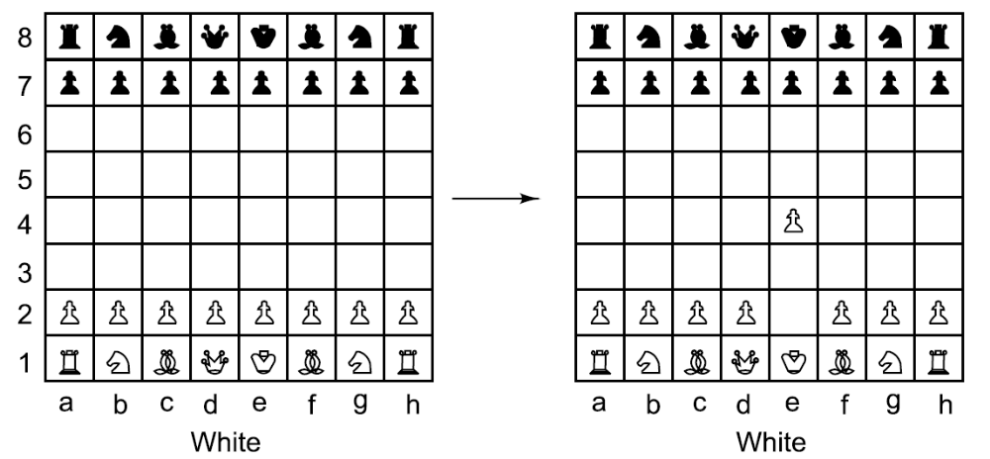
One Legal Chess Move
17

Slide 6
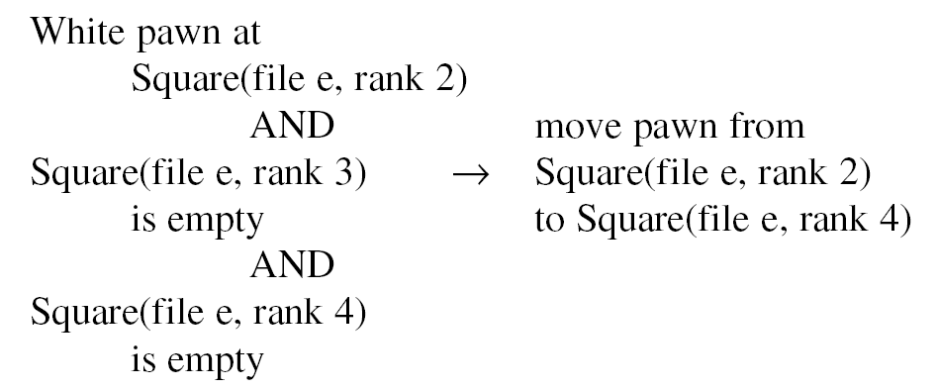
Another Way to Describe Chess Moves
18

Slide 7
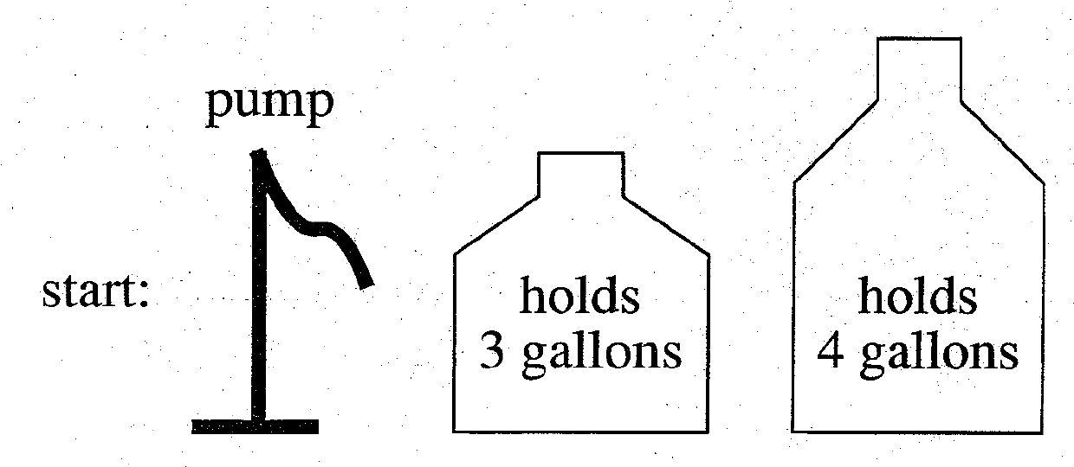
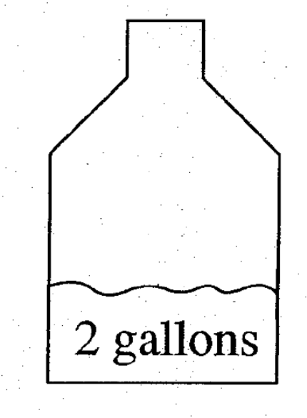
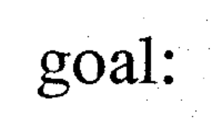
A Water Jug Problem
19

Slide 8
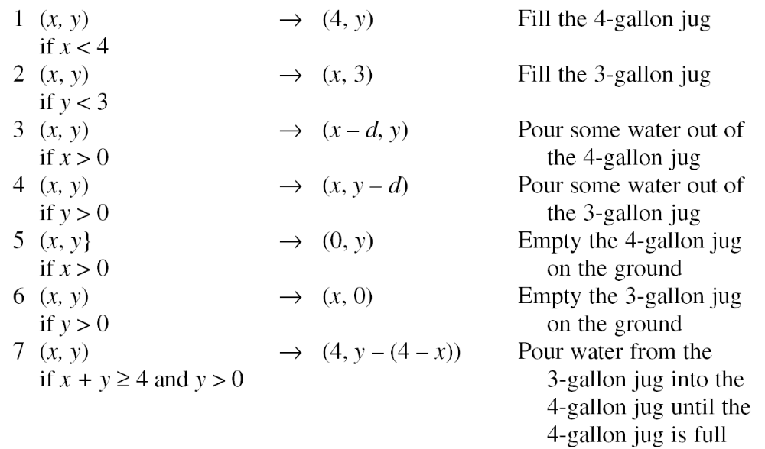
Production Rules for the
Water Jug Problem
20

Slide 9
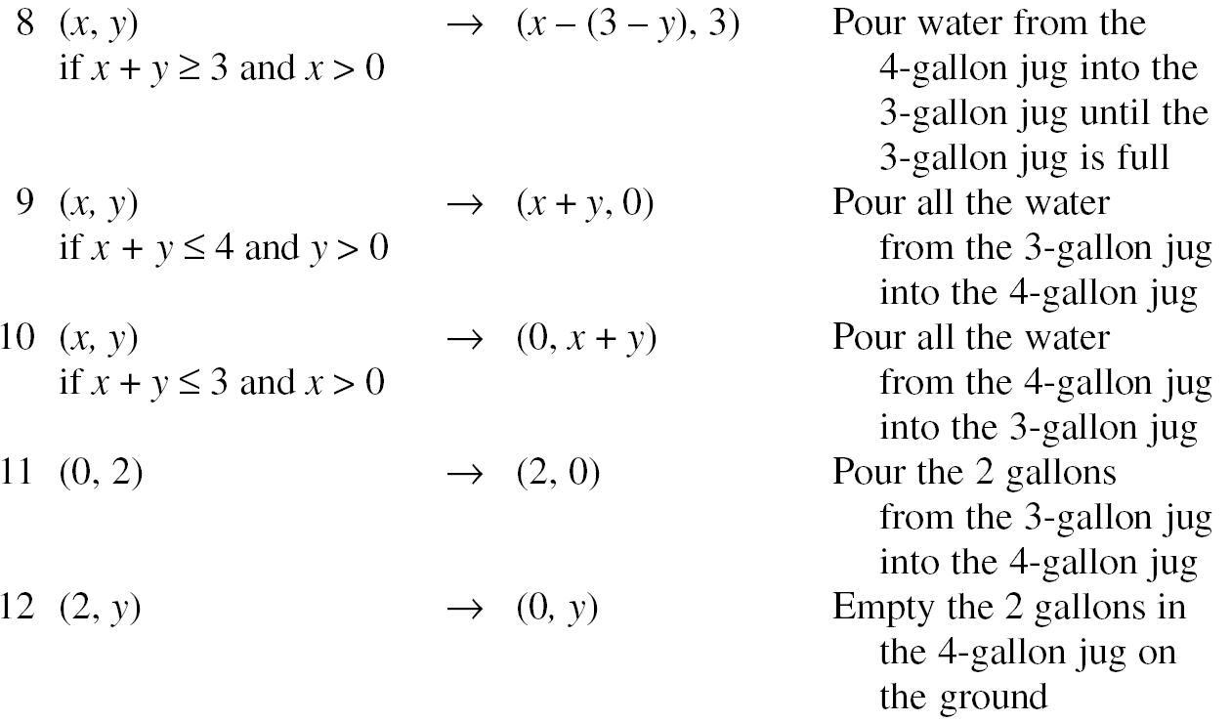
A Water Jug Problem (Cont’d)
21

Slide 10
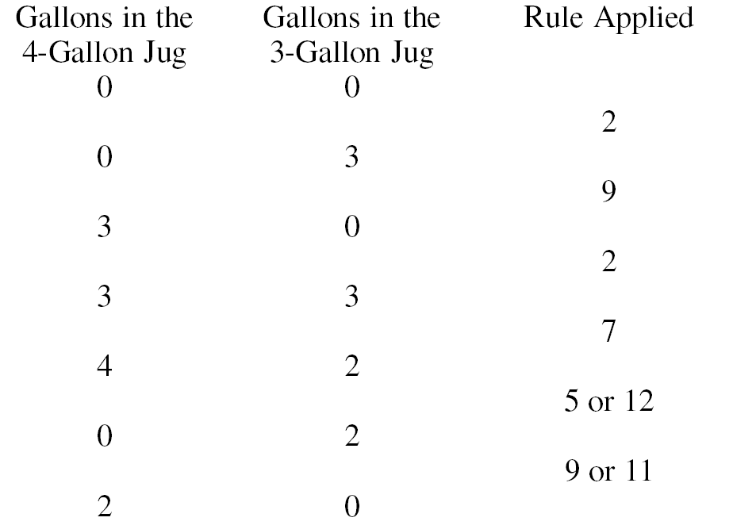
One Solution to the
Water Jug Problem
22

Slide 11
To Specify a Problem
Define the state space.
Specify the initial states.
Specify the goal states.
Specify the operations.
23

Slide 12
Production Systems
A set of rules.
Knowledge/databases.
A control strategy.
A rule applier.
24

Slide 13
Algorithm : Breadth-First Search
Create a variable called NODE-LIST and set it to the initial state.
2. Until a goal state is found or NODE-LIST is empty:
Remove the first element from NODE-LIST and call it E. If NODE-LIST was empty, quit.
(b) For each way that each rule can match the state described in E do:
  (i) Apply the rule to generate a new state,
  (ii) If the new state is a goal state, quit and return this state.
  (iii) Otherwise, add the new state to the end of NODE-LIST.
25

Slide 14
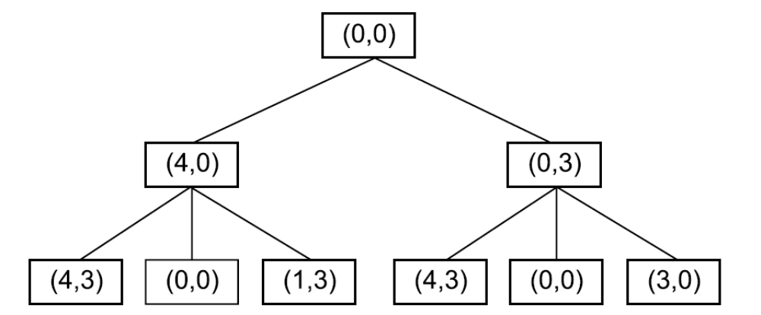
Two Levels of a Breadth-First
Search Tree
26

Slide 15
Algorithm : Depth-First Search
If the initial state is a goal state, quit and return success.
2. Otherwise, do the following until success or failure is signaled:
  Generate a successor, E, of the initial state. If there are no more successors, signal failure.
  (b) Call Depth-First Search with E as the initial state.
  (c) If success is returned, signal success. Otherwise continue in this loop.
27

Slide 16
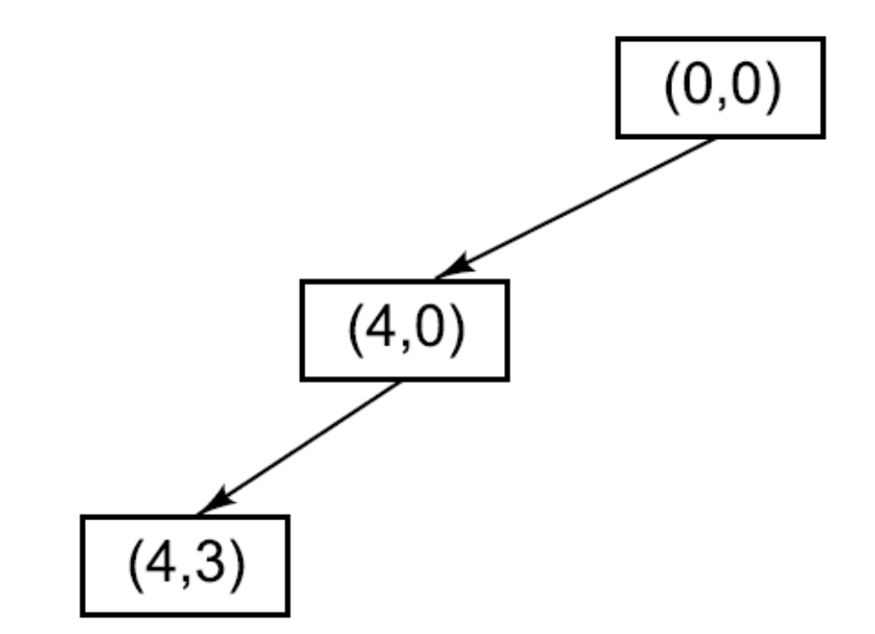
A Depth-First Search Tree
28

Slide 17
Some Simple Heuristic Functions
Chess
The material advantage of our side over the opponent
Traveling Salesman
The sum of the distances so far
Tic-Tac-Toe
1 for each row in which we could win and in which we already have one piece plus 2 for each such row in which we have to pieces.
29

Slide 18
Problem Characteristics
• Is the problem decomposable into a set of (nearly) independent smaller or easier subproblems?
• Can solution steps be ignored or at least undone if they prove unwise?
• Is the problem’s universe predictable?
• Is a good solution to the problem obvious without comparison to all other possible solutions?
• Is the desired solution a state of the world or a path to a state?
• Is a large amount of knowledge absolutely required to solve the problem, or is knowledge important only to constrain the search?
• Can a computer that is simply given the problem return the solution, or will the solution of the problem require interaction between the computer and a person?
30

Slide 19
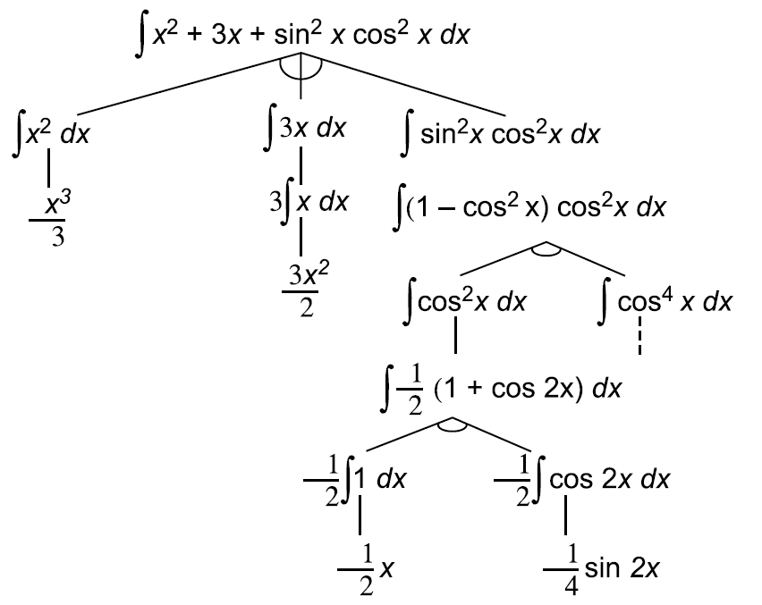
A Decomposable Problem
31

Slide 20
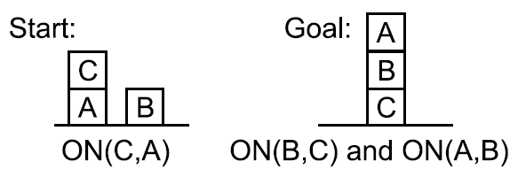
A Simple Blocks World Problem
32

Slide 21
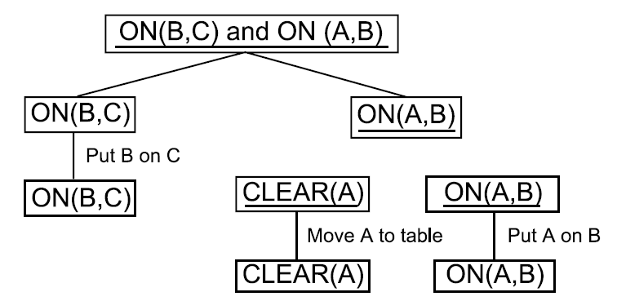
A Proposed Solution for the
Blocks Problem
33

Slide 22
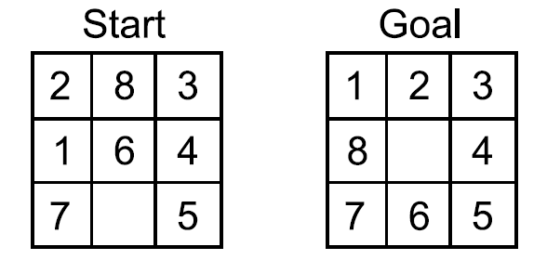
An Example of the 8-Puzzle
34

Slide 23
Facts about Marcus
1. Marcus was a man.
2. Marcus was a Pompeian.
3. Marcus was born in 40 A.D.
4. All men are mortal.
5. All Pompeians died when the volcano erupted in 79 A.D.
6. No mortal lives longer than 150 years.
7. It is now 1991 A.D.
35

Slide 24
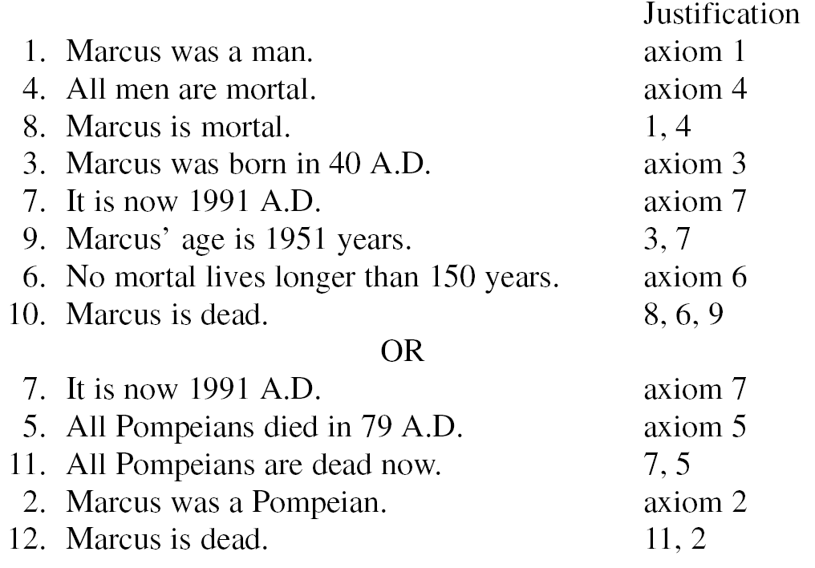
Two Ways of Deciding That Marcus is Dead
36

Slide 25
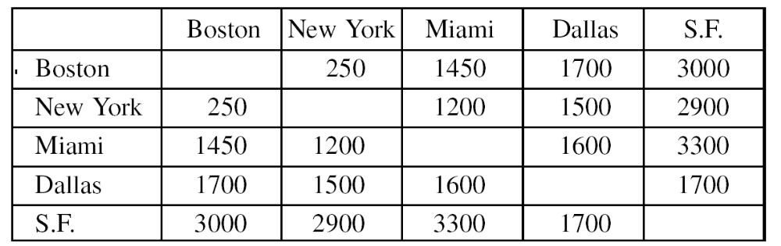
An Instance of the Traveling Salesman Problem
37

Slide 26
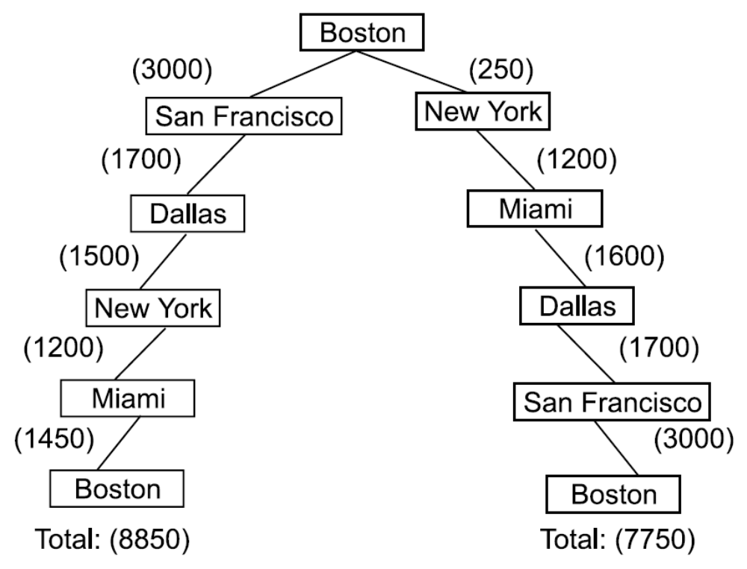
Two Paths Among the Cities
38

Slide 27
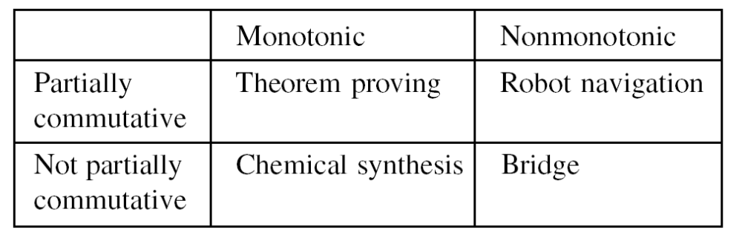
The Four Categories of Production Systems
39

Slide 28
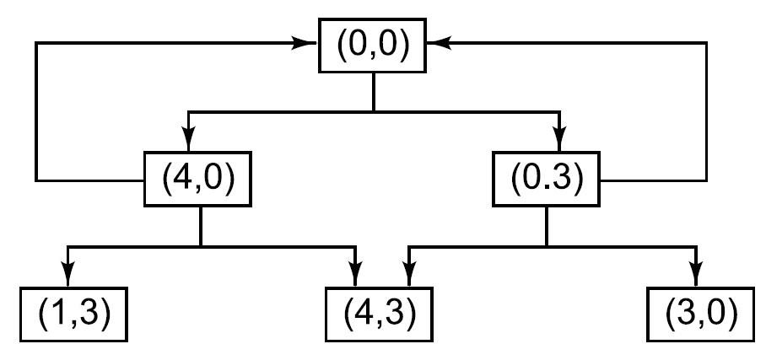
A Search Graph for the Water
Jug Problem
40

Slide 29
Algorithm : Check Duplicate Nodes
Examine the set of nodes that have been created so far to see if the new node already exists.
2. If it does not-simply add it to the graph just as for a tree.
3. If it does already exist, then do the following:
Set the node that is being expanded to point to the already existing-node corresponding to its successor rather than to the new one. The new one can simply be thrown away.
(b) If you are keeping track of the best (shortest or otherwise least-cost) path to each node, then check to see if the new path is better or worse than the old one. If worse, do nothing. If better, record the new path as the correct path to use to get to the node and propagate the corresponding change in cost down through successor nodes as necessary.
41

Slide 30

Some Cryptarithmetic Problems
42

Slide 31
Summary
In this chapter, we have discussed the first two steps that must be taken toward the design of a program to solve a particular problem:
Define the problem precisely. Specify the problem space, the operators for moving within the space, and the starting and goal state(s).
2. Analyze the problem to determine where it falls with respect to seven important issues. The last two steps for developing a program to solve that problem are, of course:
3. Identify and represent the knowledge required by the task.
4. Choose one or more techniques for problem solving, and apply those techniques to the problem. Several general-purpose, problem-solving techniques are presented in the next chapter, and several of them have already been alluded to in the discussion of the problem characteristics in this chapter. The relationships between problem characteristics and specific techniques should become even clearer as we goon. Then, in Part II, we discuss the issue of how domain knowledge is to be represented.

